Slide 1
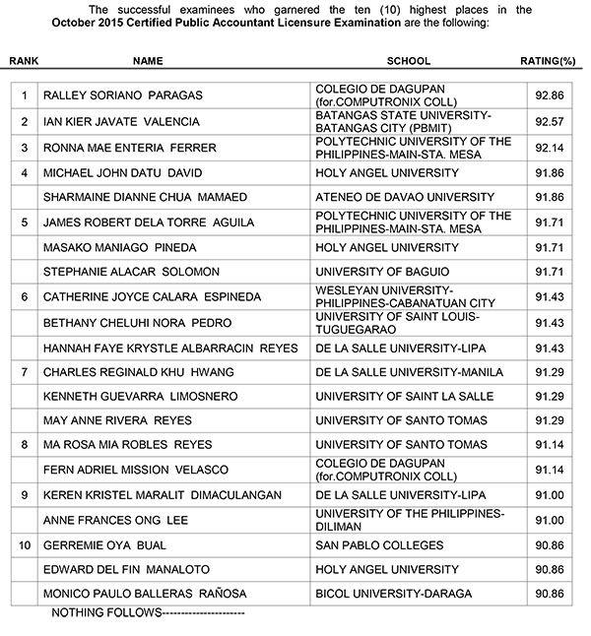

Year 1 Language Arts IOP
See Tow Shiun Hou (23) 1.09
Topic 2: Compare and contrast the climax and conclusion of 2 short stories. Compare it’s effectiveness.
Stories Chosen:
Selvi (Assigned)
Iswaran

Slide 2




Summary of Iswaran
Failure
Iswaran fails the exam dozens of times
Word that he “aged in the Intermediate Class
Movie
Iswaran, on the day of receiving the results, watches 2 movies.
Results
Iswaran checks the results board and finds his name not there. He feels that he had failed his parents and contemplated suicide.
He finds his name in the honours board and his excitement, he hallucinated and killed himself.
He wants to de-stress before receiving the results

Slide 3

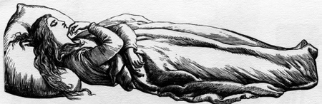
Summary of Selvi
Exploit
Selvi’s voice is constantly exploited by Mohan, who is using it for his personal gain.
Death
When Selvi’s mother passes on, Selvi realises that she had spent more time serving Mohan than with her mother.
Rebellion
Selvi decides not to continue singing for Mohan.
She stays in her ancestral home and gives free singing sessions
She is viewed as rare to the point where “none could get a glimpse of her, only of Mohan’s secretary or of the secretary’s secretary”

Slide 4
Similarities
Both stories involve a reasonable amount of grief to the point where when Selvi heard it, she "refused to come out of her hotel room" and "wanted all her engagements cancelled."
They both show a shocked protagonist, and what they do afterward. Selvi became "truculent and violent" and Iswaran imagined a horse and he felt the horse "make a leap."
This shows their take on such a situation..

Slide 5
Differences
Iswaran
Iswaran “accidentally” in his state of mind jumped into the river by imagining a horse "make(ing) a leap" into the water and drowned.
The reactions of the 2 protagonists are different.
The next afternoon people found his letter to his Father and thought that he thought that he was a dunce, unlike his brothers which were "not such dunces as he was.
Selvi
She reacts differently (i.e.. She creates free music for all
She decides to stop serving Mohan
She finally realises her predicament and fights against him
“All through the train journey back, she kept looking out of the window and never spoke a word, although Mohan did his best to engage her in talk.”
Mohan tried to cut short his narration and send him away, since it was unusual to let a nondescript talk to Selvi directly. But she said to Mohan, ‘You may go back to the Terrace if you like. I’m staying here.’ Mohan had not expected her to talk to him in that manner.
He had never known her to be so truculent or voluble.

Slide 6
Which Is More Effective?
Iswaran
Exam related – What we experience
Shows his strong reactions to getting exam results, similar to us as he "scanned the board for his name."
Plot twist, comes as a shock as he found that "his name was nowhere"
It leaves readers in suspense, wondering what he will do next as "he felt like a conqueror" and "the air rushed around him".
“But now after he gazed at the notice-board for quite a while, the grim reality of his failure dawned on him: his number was nowhere.”
“‘I have five hundred and one horses,’ he spoke to the night. The number stuck in his mind and kept coming up again and again.”
“He felt like a conqueror as the air rushed about him.”
“He felt the horse make a leap.”

Slide 7

Thank You
Credits:
Fonts:
Apple Inc – San Francisco, Helvetica, Helvetica Neue
Microsoft Corp – Arial, Comic Sans MS, Calibri
Google – Product Sans
Images:
Thank you – fuseliterary.com
Singer - depositphotos.com
Stickman with horse – imgur.com
This image has been used so many times.

